Slide 1


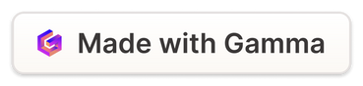
Exploratory Data Analysis (EDA) of Financial Transactions
Uncovering Key Trends and Insights from Financial Data
This presentation summarizes an exploratory data analysis of financial transactions. We aim to reveal hidden patterns and trends.
MR
Notes:
1

Slide 2
Dataset Overview
Sources
Scope
Methodology
Data was gathered from banks and credit unions.
The dataset spans two years, 2022-2023.
EDA techniques used data cleaning and pattern mapping.
Notes:
2

Slide 3
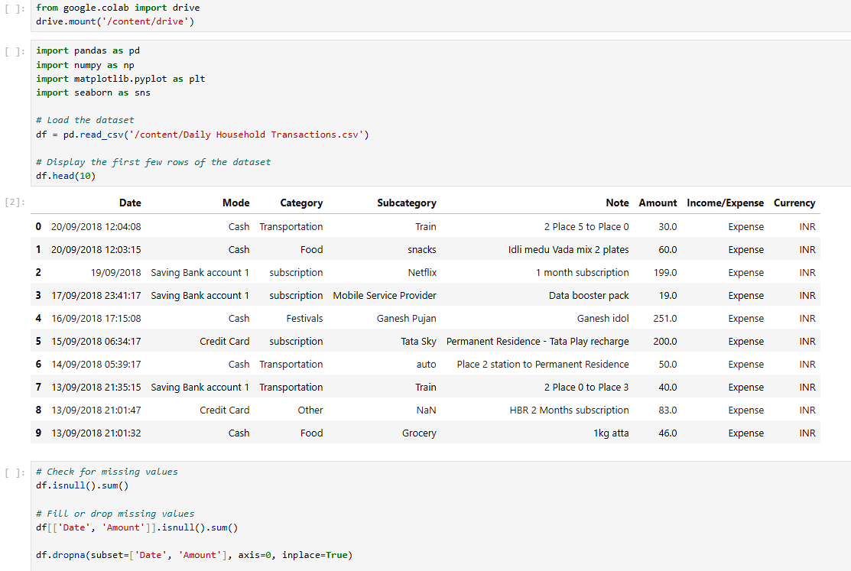
DATA CLEANING

Slide 4
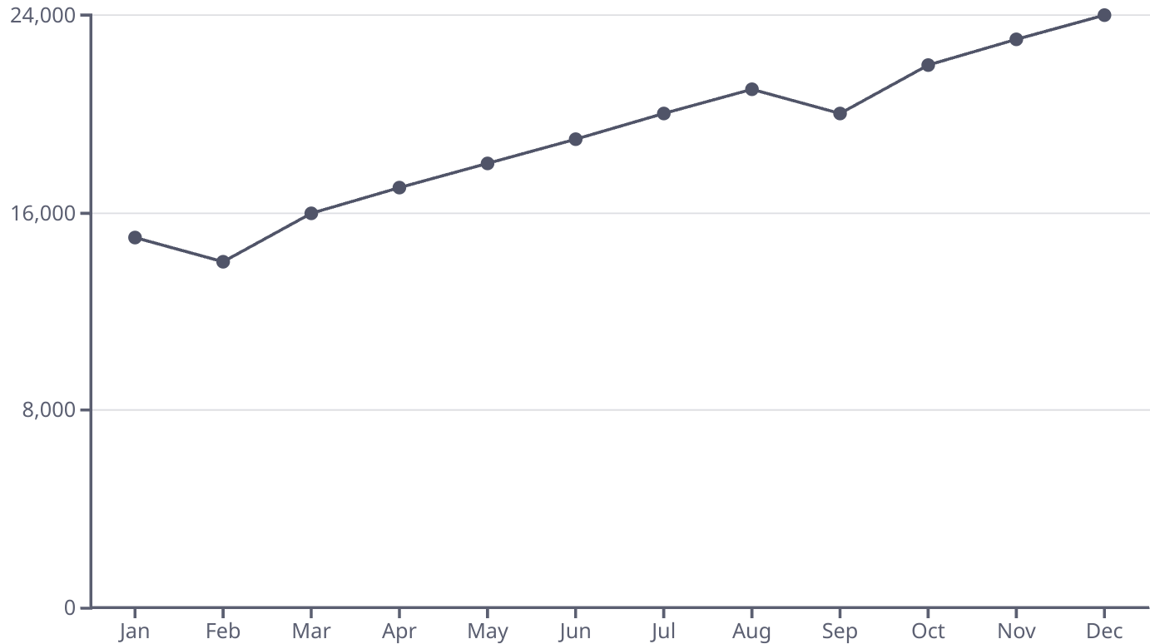
Transaction Volume & Temporal Patterns
Transaction volumes show seasonality. Peaks occur during the holiday season.
Notes:
3

Slide 5
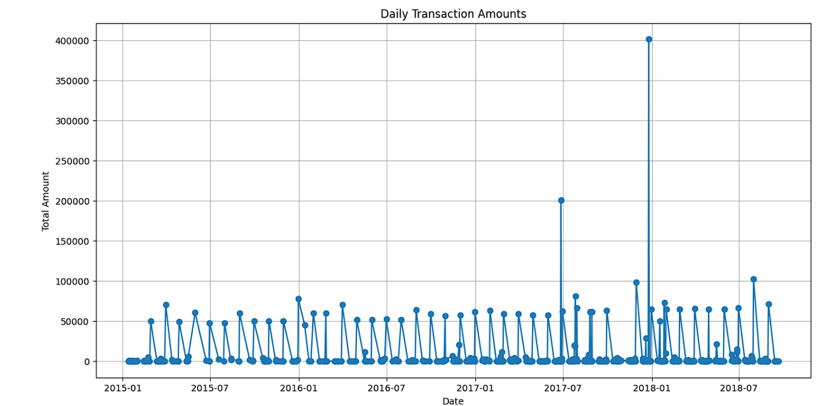
DAILY TRANSACTION AMOUNTS

Slide 6
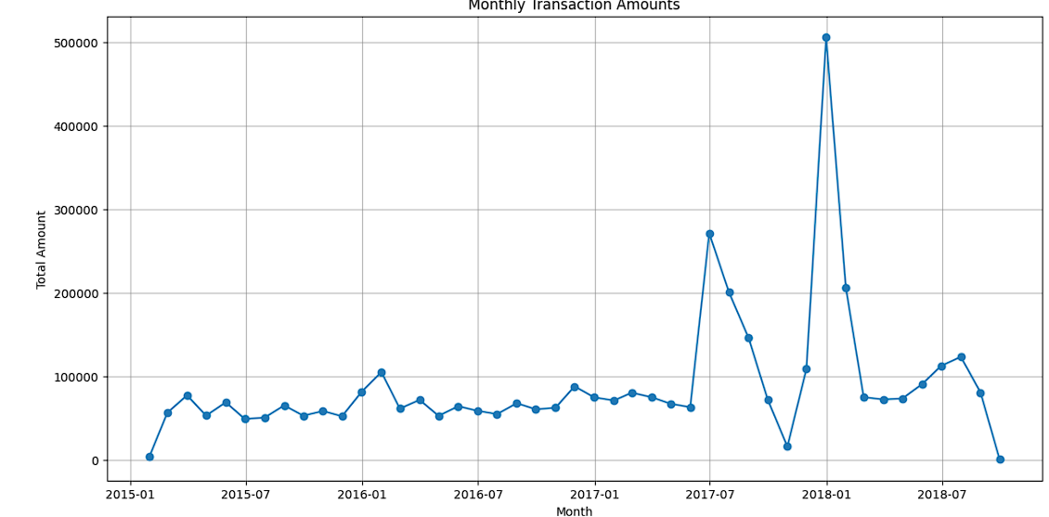
MONTHLY TRANSACTION AMOUNTS

Slide 7
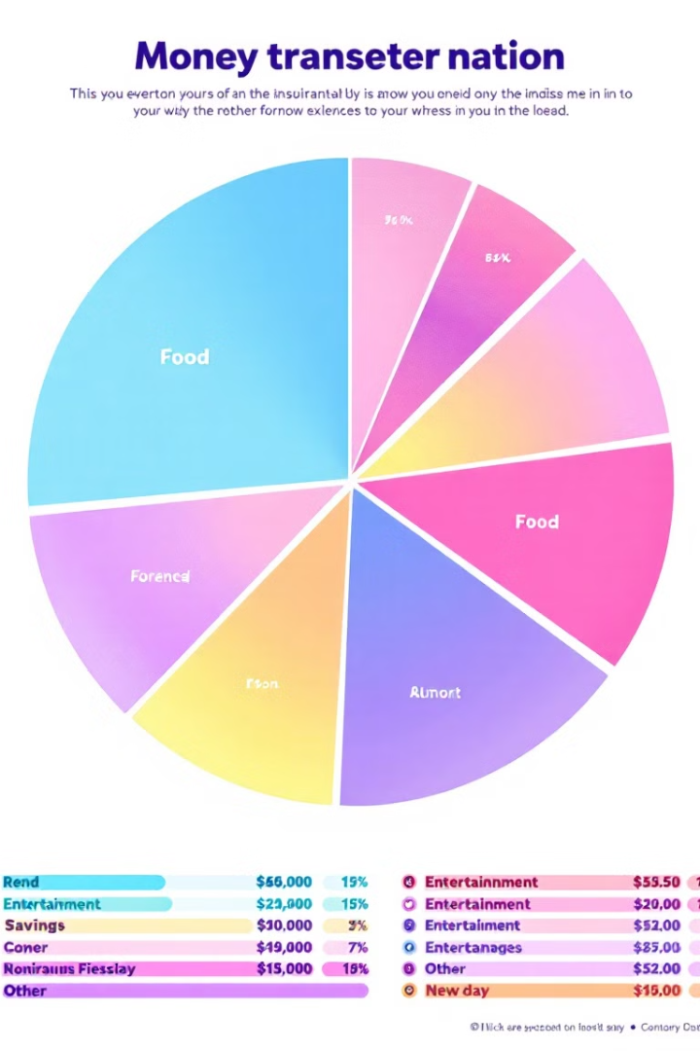
Categorical Analysis
Payment Types
Transaction Channels
Credit cards are the dominant payment method.
Online transactions are steadily increasing over time.
Merchant Category
Retail shows the highest transaction count.
Notes:
4

Slide 8
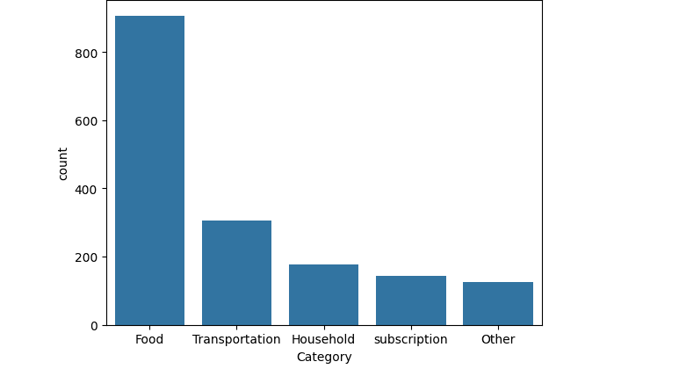
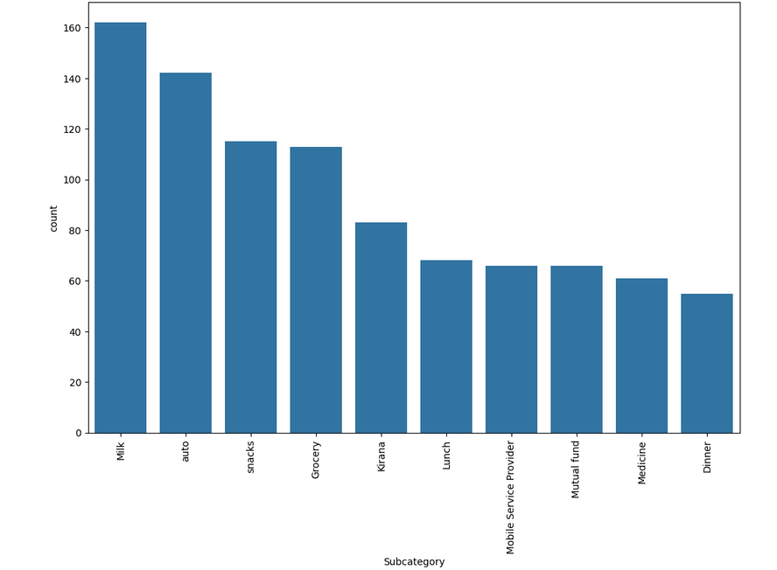
CATEGORY
SUBCATEGORY
VS

Slide 9




Geographic Distribution
Urban Centers
Higher transaction density is located in major cities.
Rural Regions
Lower transaction volume in rural areas.
Coastal Areas
Significant transaction activities are happening near the coast.
Notes:
5

Slide 10
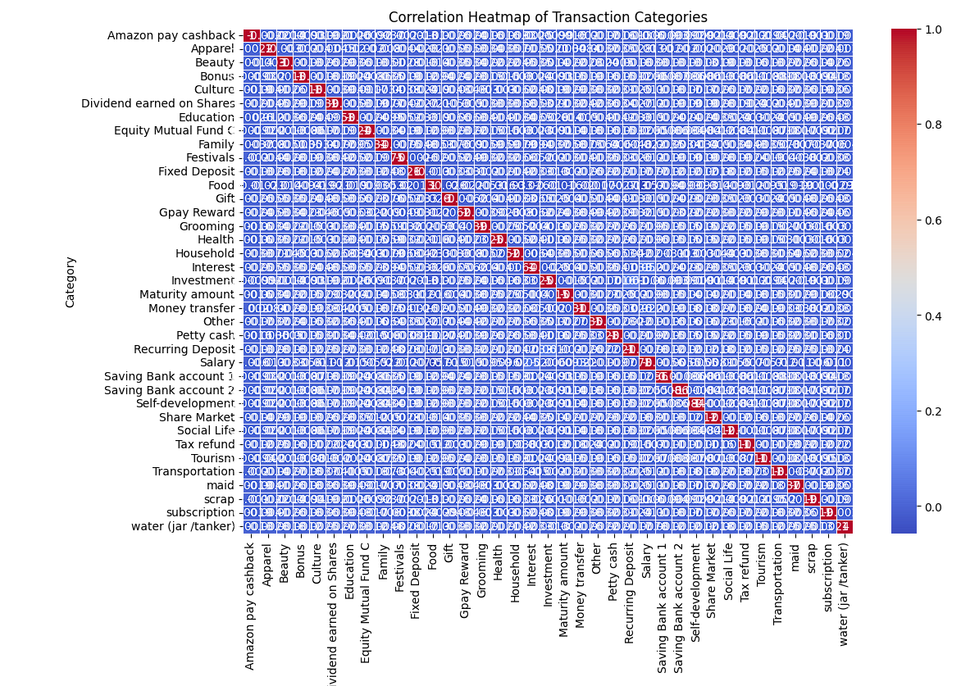
VISUALIZATION BASED ON TRANSACTION CATEGORIES

Slide 11
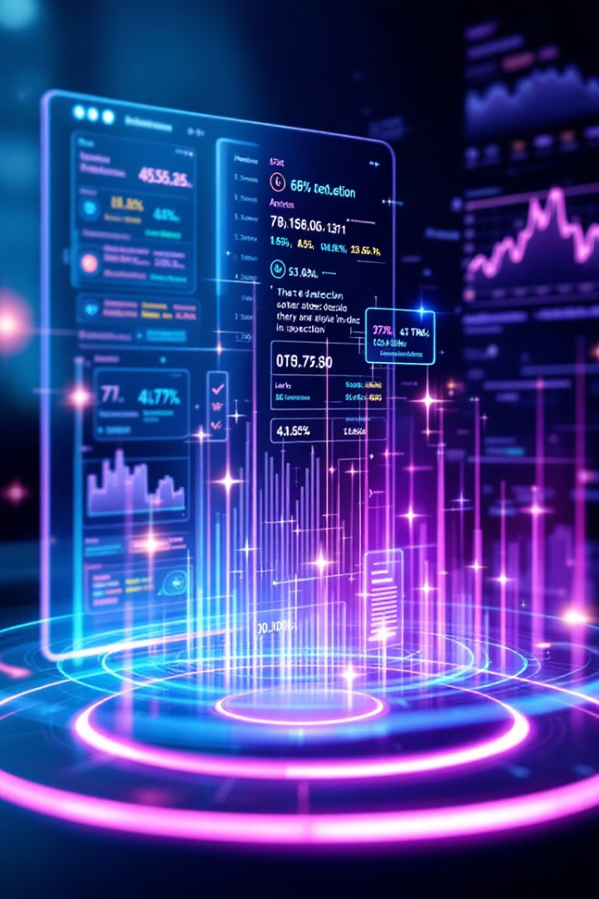



Risk and Anomaly Detection
Unusual Patterns
High-Risk Transactions
Mitigation Steps
Detected anomalies show deviations from typical spending.
Recommendations include enhanced authentication and monitoring.
Identified potential fraudulent activities by scanning transaction amounts and frequency.
Notes:
6

Slide 12

Statistical Correlations
1
Time of Day
Spending habits vary significantly throughout the day.
2
Transaction Size
Larger transactions often occur during the weekdays.
3
Customer Demographics
Different age groups exhibit distinct spending behaviors.
Notes:
7

Slide 13
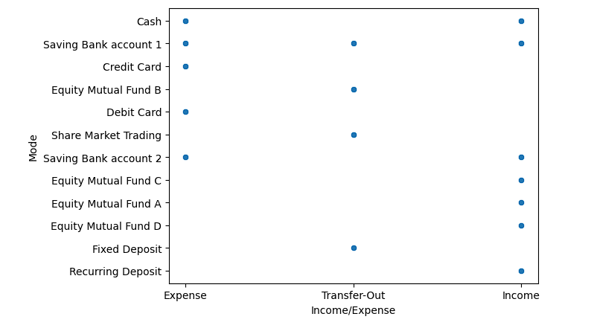
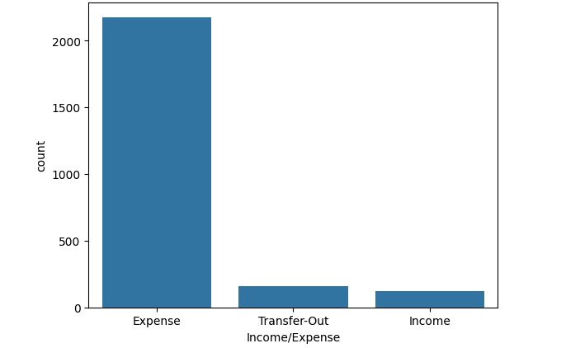
INCOME
&
EXPENSE FLOW

Slide 14
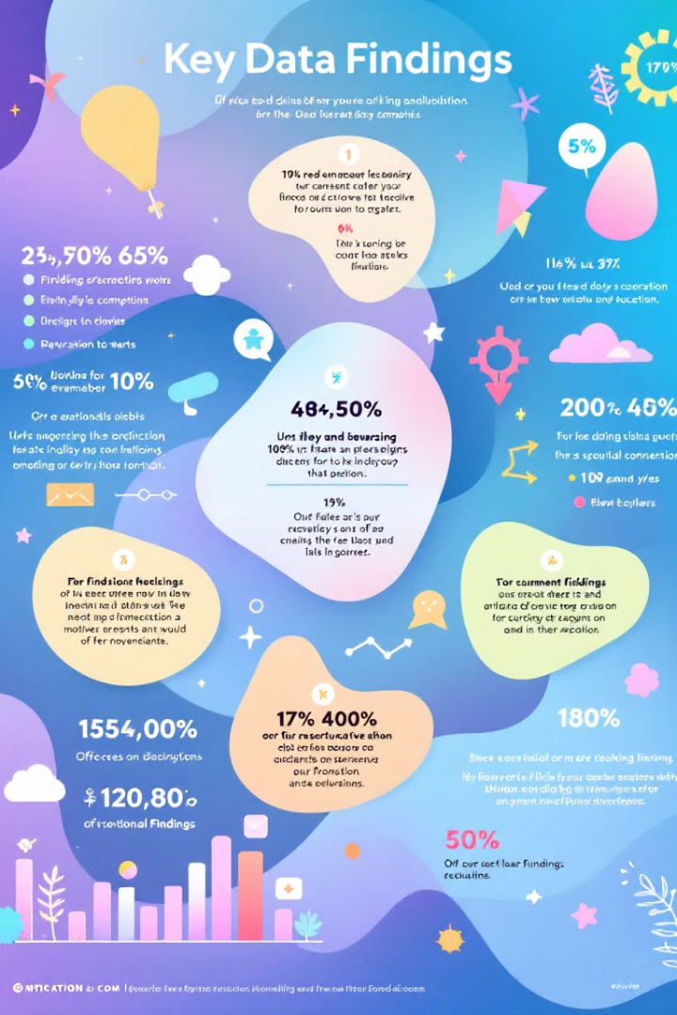
Key Findings and Recommendations
1
Seasonality
2
Payment Preference
Transaction volumes peak during holidays.
Credit card use is highly prevalent.
3
Anomaly Detection
Important to monitor for fraudulent activities.
Future research: Deep dive into consumer behavior. Implement real time fraud analysis.
Notes:
8

